Slide 1
React Installation and execution

Slide 2
How to create React Application
React application without installation:
We can also create a React app without npm(Node Package Manager) by directly importing Reactjs library in our HTML code.
This is exactly what we will do here. Here are the steps required to create and run a React app without npm.
React Application with installation:
First, you use npm (Node Package Manager) installed on your machine.
If you’re using VS Code, you need to make sure you’ve configured your machine to run React code in VS code using npm.
You will also need to setup a build environment for React that typically involved use of npm (node package manager), webpack, and Babel.

Slide 3
Executing React: Without npm(Node Package Manager)
React JS Without installation
React can work with installation as well as without installation
However, for fresher's or those who are learning for the first time, React can be made use by without installation
On the other hand if we are working in a project we need to install react in the system
In order to make use of react without any installation we will use the concept of CDN which stands for Content Delivery network

Slide 4
React application without installation
HTML
Java Script
Browser

Slide 5
NPM and NPX
What is NPM : NPM stands for Node Package Manager. It comes pre-installed with Node.js. NPM is used to install Node.js packages to use them in our application. It makes it easier for developers to share and reuse open source code by enabling them to be installed as modules. Modules are JavaScript packages that you can install in your system using NPM. NPM helps to manage packages in your projects as dependencies.
NPX is an NPM package executor. Initially, NPX was launched in July 2017. NPX was just an NPM package that could be installed like other NPM packages. Currently, NPX is bundled with NPM when you install the NPM version 5.2.0 or higher.

Slide 6
Difference between NPM and NPX
npm | npx
If you wish to run package through npm then you have to specify that package in your package.json and installed it locally. | A package can be executable without installing the package, it is an npm package runner so if any packages that aren’t already installed it will installed automatically.
To use create-react-app in npm the commands are npm install create-react-app then create-react-app myApp(Installation required). | But in npx you can use that without installing like npx create-react-app myApp, this command is required in every app’s life cycle only once.
Npm is a tool that use to install packages. | Npx is a tool that use to execute packages.
Packages used by npm are installed globally you have to care about pollution for the long term. | Packages used by npx are not installed globally so you have to carefree for the pollution for the long term.

Slide 7
Steps to execute React without npm
We will create an HTML page
Then we will insert three CDN links
Then we will write some HTML code
Then some react code
And then our example will be complete
In other words React App
[React_cdn.html]

Slide 8
React Installation

Slide 9
React with Installation
Process
The first step is to create a folder where you want to install react project. You can use DOS command or whatever it is

Slide 10
Execution Pre-requisit
Download and install Visual Studio Code
Download and install Node.js
You can install npm by installing Node.js.
Tocheck required softwares are installed or not
Check node installation < node -v>
Check npm installation <npm –v>
npx create-react-app <app name> [For creating new React Project]
cd <app name> [Enter in Project folder]
create-react-app includes built tools such as webpack, Babel, and ESLint.
To start new project [npm start]
New project will open in Visual Studio Code

Slide 11
React Installation
Creating a First React App with Node JS
In order to start we first need node JS and NPM so we install it first in our computer
Goto google and type install node. Select the link for download Node JS.
https://nodejs.org/en/download/
Select windows installer as the case may be
Run the installer
Keep on accepting the messages to complete the installation
Go to command prompt and check whether npx and npm is working or not.
Windows installer
Install node.js
Command to check node.js installation
Restart your computer to run node.js
node –v [To check node is installed]
npm –v [To check npm is installed]
To check node is working [node java_script.js] runt his file
Type npx of npm at the command prompt to ensure that it has installed successfully

Slide 12
Creating first react application
Creating a First React App with Node JS
In order to create the app. Go to the director where you want to create an application.
Type at the command prompt the following
Npx create-react-app my-app
After some times a folder with my-app is created.
Go to this app by typing cd my-app
Type npm start at the command prompt to see the first re-act app.
npm start [will start this application]

Slide 13
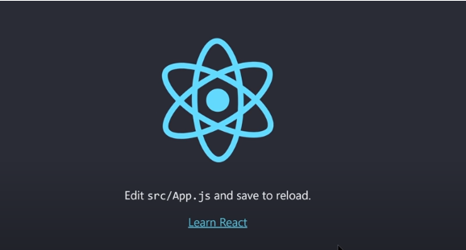
First React Project Output

Slide 14
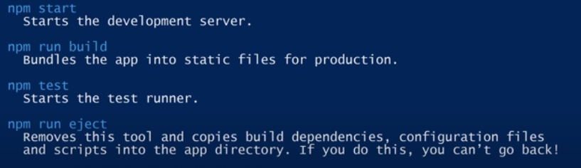
Background Activities during React App
Back ground Activities during the creation of React App

Slide 15
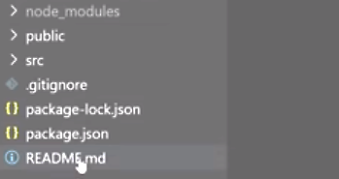
File structure of React Application
Understanding the file structure

Slide 16
React Application File Structure
Readme MD :
It is a simple plain text file that contains the basic information of the files and some guides.
It is used to write some installation guide or basic documentation inside the project directory.
Most popular repository providers like GitHub, gitlab and bitbucket are using the readme.md file as a file descriptor.
Package JSON :
All npm packages contain a file, usually in the project root, called package. json - this file holds various metadata relevant to the project.
This file is used to give information to npm that allows it to identify the project as well as handle the project's dependencies.
package-lock. Json
is automatically generated for any operations where npm modifies either the node_modules tree, or package. json .
It describes the exact tree that was generated, such that subsequent installs are able to generate identical trees, regardless of intermediate dependency updates.

Slide 17
gitignore
file is a text file that tells Git which files or folders to ignore in a project.
A local . gitignore file is usually placed in the root directory of a project.
... Each new line should list an additional file or folder that you want Git to ignore
src Folder:
The most common src folder looks somewhat like this: Common src folder structure. Now, let's go over the folders one by one and the and understand the motivation behind them and the type of files you would store in them: Assets: This folder contains all the media assets, such as images, videos, json files
public folder:
contains the HTML file so you can tweak it, for example, to set the page title.
The <script> tag with the compiled code will be added to it automatically during the build process

Slide 18
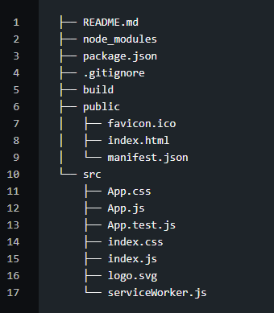
React Application File Structure
Understanding the file structure
The following visuals depict the file structure of the react project app.

Slide 19
React Application file Structure
Build represents the path to our final production build. This folder would actually be created after we run the npm build.
We can see all the "dependencies" and "devDependencies" required by our React app in node_modules. These are as specified or seen in our package.json file. If we just write dir at the command prompt we‘will see almost 800 sub-directories. This directory gets added to .gitignore so it does not really get uploaded/published as such.
Our static files are located in the public directory.
All of the dynamic components will be located in the src.

Slide 20
Files inside “src” directories
We can also see files like App.js which is kind of our main JS component and the corresponding styles go in App.css.
In case, we want to add any unit tests, we can use the App.test.js for that. Also, index.js is the entry point for our App and it triggers the registerServiceWorker.js.
As a side-note, we mostly add a 'components' directory here to add new components and their associated files, as that improves the organization of our structure.

Slide 21
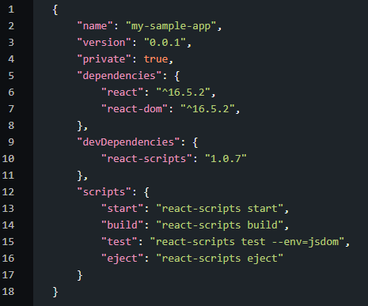
Package.json: React Application Configuration
The overall configuration for the React project is outlined in the package.json. Below is what that looks like:

Slide 22
Attributes Inside Package.json
name - Represents the app name which was passed to create-react-app.
version - Shows the current version.
dependencies - List of all the required modules/versions for our app. By default, npm would install the most recent major version.
devDependencies - Lists all the modules/versions for running the app in a development environment.
scripts - List of all the aliases that can be used to access react-scripts commands in an efficient manner. For example, if we run npm build in the command line, it would run "react-scripts build" internally.

Slide 23
We can see the following attributes:
The dependencies which are shared by our application can go to the assets directory.
These can include mixins, images, etc.
Thus, they would represent a single location for files external to our main project itself.
We also need to have a utilities folder.
This would contain a list of helper functions used globally across the app.
We can add common logic to this utilities folder and import that wherever we want to use it. While the naming can vary slightly, the standard naming conventions are seen include helpers, utils, utilities, etc.

Slide 24
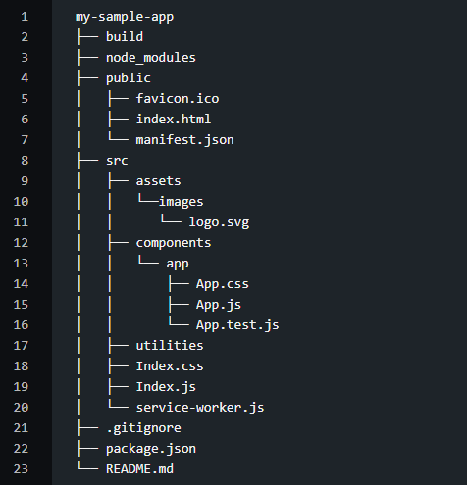
Full Stack Development
With that, our structure would now looks something like below:

Slide 25
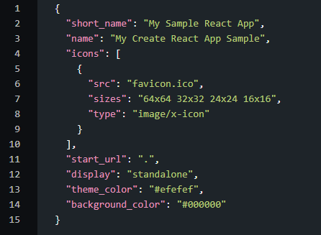
Mainifest.json : Our Application on Mobile
manifest.json This file is used to describe our app e.g. On mobile phones, if a shortcut is added to the home screen. Below is how that would look like;

Slide 26
When our web app is added to user's home screen, it is this metadata which determines the icon, theme colors, names, etc. favicon.ico
This is the icon image file used by our project. It is also linked inside index.html and manifest.json.

Slide 27

IDE for React
Go to google and write download visual studio code
Choose your operating system
Download visual studio code
Install visual studio code

Slide 28
What is React Element?
React Element:
It is the basic building block in a react application, it is an object representation of a virtual DOM node.
React Element contains both type and property.
It may contain other Elements in its props.
React Element does not have any methods, making it light and faster to render than components.

Slide 29
ReactDOM.render()
The ReactDOM.render() function takes two arguments,
HTML code
an HTML element.
The purpose of the function is to display the specified HTML code inside the specified HTML element.
ReactDOM.render() is rendering code to a folder in the root directory of your React project, named "public". In this folder, there is an index.html file.

Slide 30
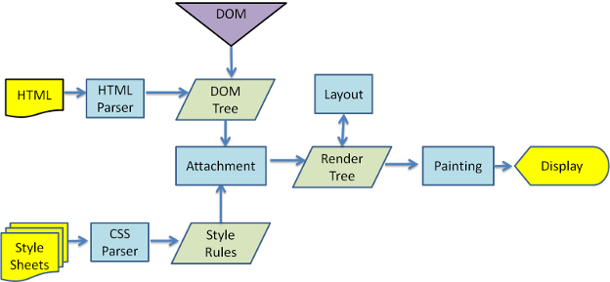
DOM Rendering

Slide 31
ReactDOM.createRoot()
createRoot() controls the contents of the container node you pass in. Any existing DOM elements inside are replaced when render is called. Later calls use React’s DOM diffing algorithm for efficient updates.
createRoot() does not modify the container node (only modifies the children of the container). It may be possible to insert a component to an existing DOM node without overwriting the existing children.

Slide 32
React Developer Tools:
React Developer Tools is a Chrome DevTools extension for the open-source React JavaScript library. It allows you to inspect the React component hierarchies in the Chrome Developer Tools.
You will get two new tabs in your Chrome DevTools: "⚛️ Components" and "⚛️ Profiler".
The Components tab shows you the root React components that were rendered on the page, as well as the subcomponents that they ended up rendering.
By selecting one of the components in the tree, you can inspect and edit its current props and state in the panel on the right. In the breadcrumbs you can inspect the selected component, the component that created it, the component that created that one, and so on.

Slide 33
Application Clean up Process for Beginners
Open your folder in Visual Studio Code and Perform a clean up operation to start a fresh Reach application with understanding.
Open src folder
Index Page
Let's also have a look inside the index.js as well as the index.html page which gets generated. Below is how our index.js file looks;

Slide 34
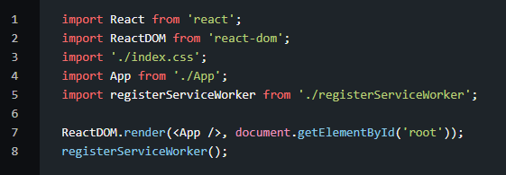
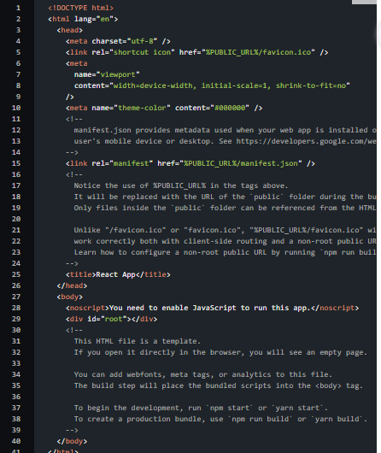

Slide 35
Moving deeper into React
Having understood the basic functioning of the React by means of visuals and installation of react app with the help of npx and npm, let us now dive deep into React.
We start with the components of React.

